Slide 1

WELCOME
SYNISE TECHNOLOGIES LTD.
RA JAPANESE AUCTION

Slide 2
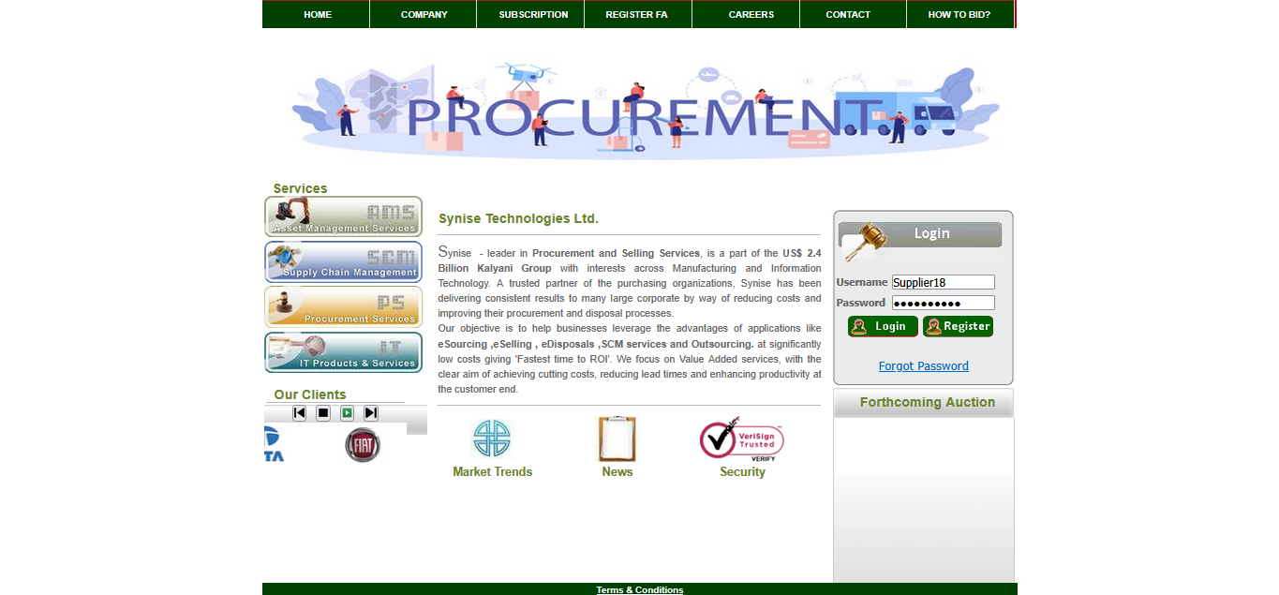
1. Check your inbox for login credentials
2. Log on to : https://indiaengineering.com/rajapaneseauction/index.aspx.
Enter the credentials received in your email and click on Login.

Slide 3
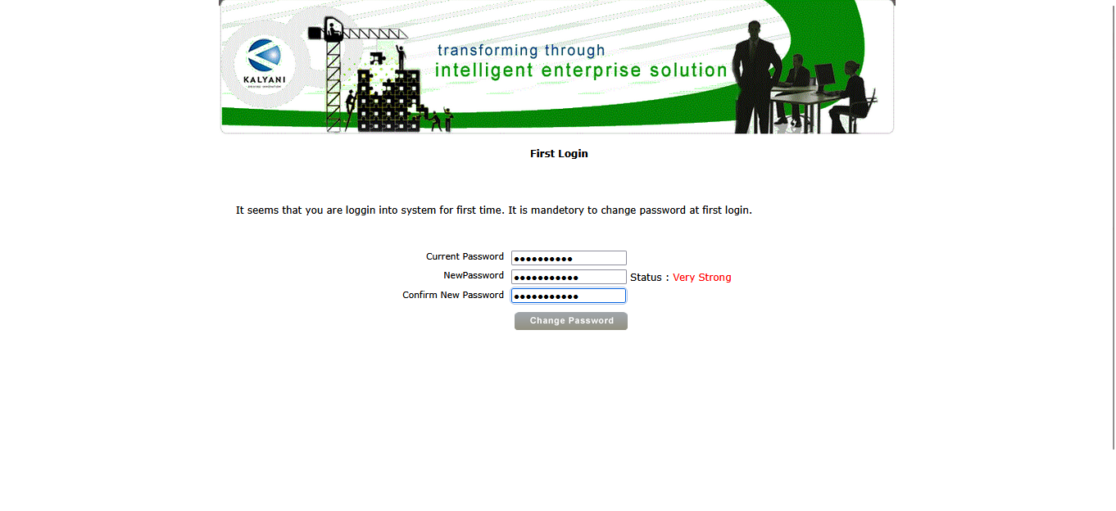
3. Update your system-generated password with a new password and click on Change Password.

Slide 4
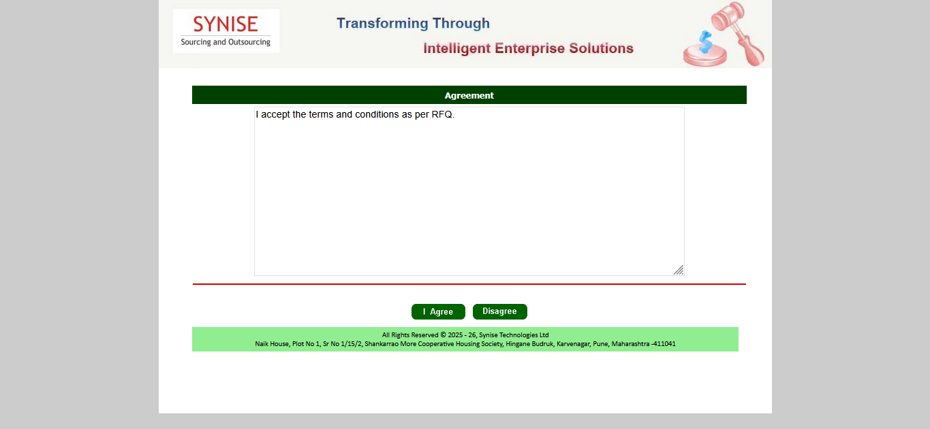
4. Click on "I Agree" to accept the agreement and successfully proceed further.
Click here

Slide 5
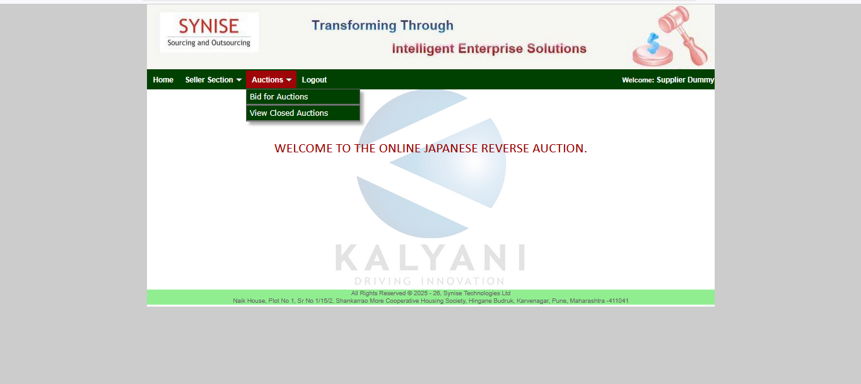
5. Go to Auctions tab under that Bid for Auctions
Click here

Slide 6
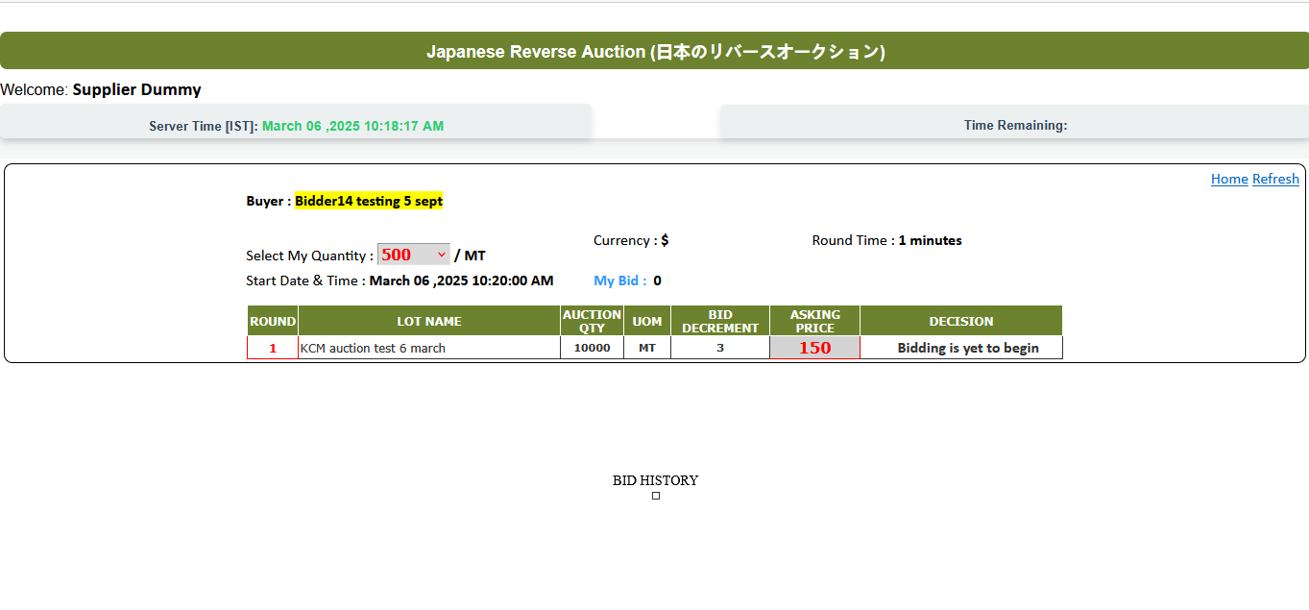
6. You can view the Auction details.
Note: Log in 15 minutes before the auction starts. If you log in after the start time, you will lose your participation..
Round Time
The Round Number is displayed here.
Material Description
Total Qty for auction & UOM
Opening Price & Bid Decrement
Auction has not started yet. Please have patience.

Slide 7
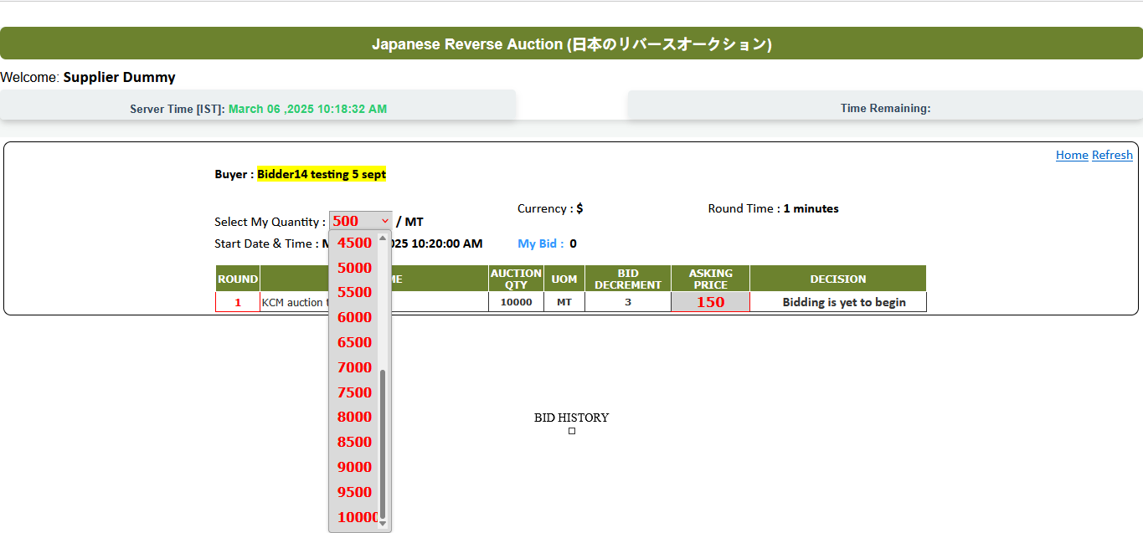
The quantity is set from Minimum to Maximum Quantity in multiples of 500 MT.
Currency of auction
Select
Qty from the dropdown

Slide 8
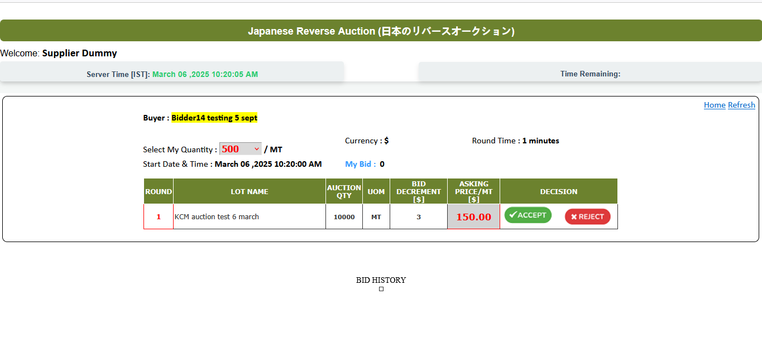
Accept: If a bidder accepts the round price, they will enter the next round after the current round ends.
Reject: If a bidder rejects the round price, they will be immediately eliminated from the auction and cannot participate in further rounds.
No Response: If a bidder does not make a decision within the given time (1 minute), they will be automatically eliminated and will not be eligible to participate in the next rounds.
Time Remaining: countdown for each round.
Select Qty and Make Decision
Take decision before Round Time ends
Accept: Click to Accept Current Round Price
Reject: Immediate elimination from auction.

Slide 9
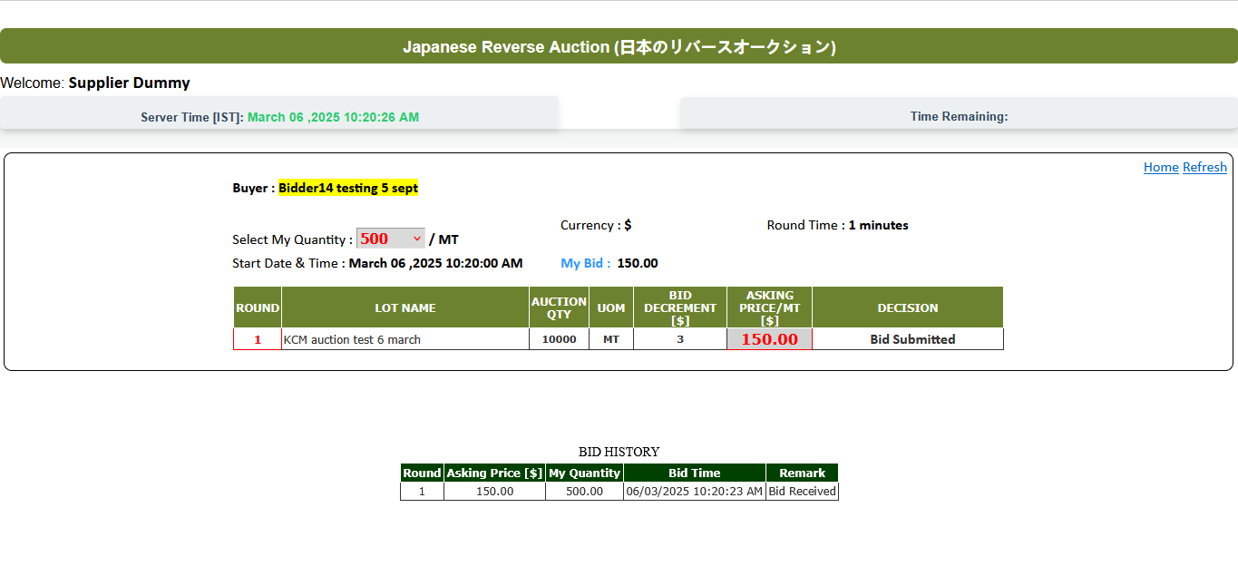
If you accept the Round 1 price:
You can view the Bid History, showing the rounds and prices you accepted.
Your bid submission status will be displayed in the Decision column.
Patiently wait for the next round to begin—it will start immediately after Round 1 ends.
Your Current Last Round Accept Price Display here
Countdown to end Round 1
After Accept you Bid Status
Bid History display here

Slide 10
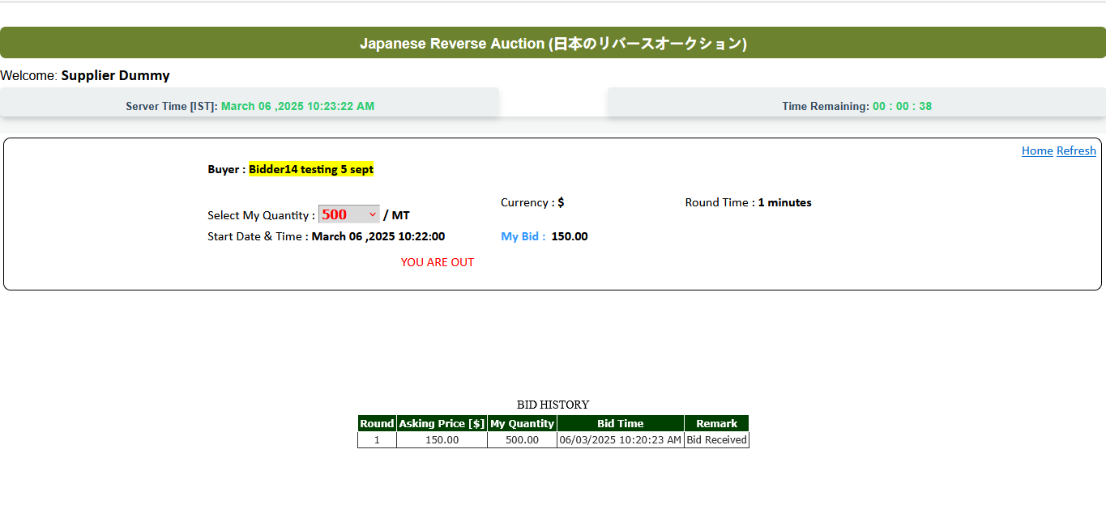
If you reject the round price:
Reject: Immediate elimination from the auction, with no further participation
OR
If you fail to make a decision within the given round time:
No Response: You will be automatically eliminated and will not be eligible for future rounds.
Eliminated from Round: You will be unable to see the next round.

Slide 11
CONTACT
Sayali Gaikwad.
AMS Executive
sayalig@synise.com
8308811812
SYNISE TECHNOLOGIES LTD.
(An ISO 9001:2015 Certified Company)
Sr No. 1/15/2, Plot No. 1,
Shankarrao More Co-Op HSG Soc,
Hingane BK, Karvenagar,
Pune -411052.
www.synise.com

